Slide 1
invalid json syntax: invalid character '\n' in string literal

Slide 2
invalid json syntax: invalid character '\n' in string literal
South America boasts a remarkable diversity of lizard species, each contributing unique ecological roles to the continent's intricate ecosystems. This comprehensive research delves into the fascinating world of South American lizards, exploring the diverse families that call this continent home.

Slide 3
invalid json syntax: invalid character '\n' in string literal
Lizards are a diverse group of reptiles found across South America, with over 1,000 species. This continent is home to various lizard families, each with its unique characteristics and ecological roles.

Slide 4
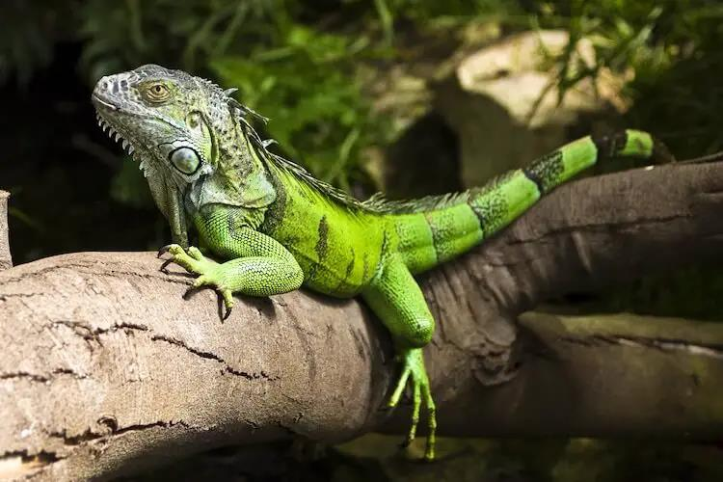

Slide 5
invalid json syntax: invalid character '\n' in string literal
The Caiman Lizard and the Tepui Lizard are two captivating reptile species found in South America. Both possess unique adaptations that allow them to thrive in their respective environments. However, they face threats such as habitat destruction and illegal trade, emphasizing the need for conservation efforts to preserve them and their critical roles in their respective ecosystems.

Slide 6
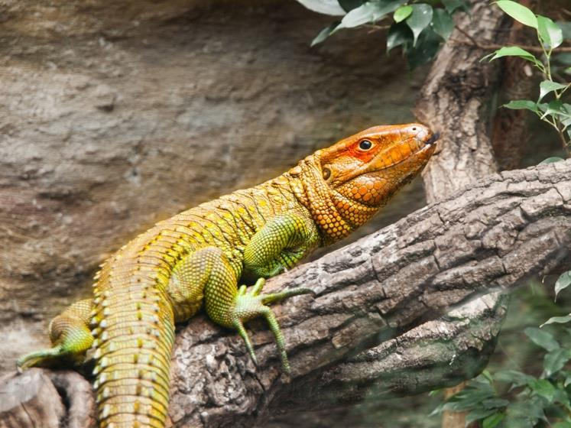

Slide 7
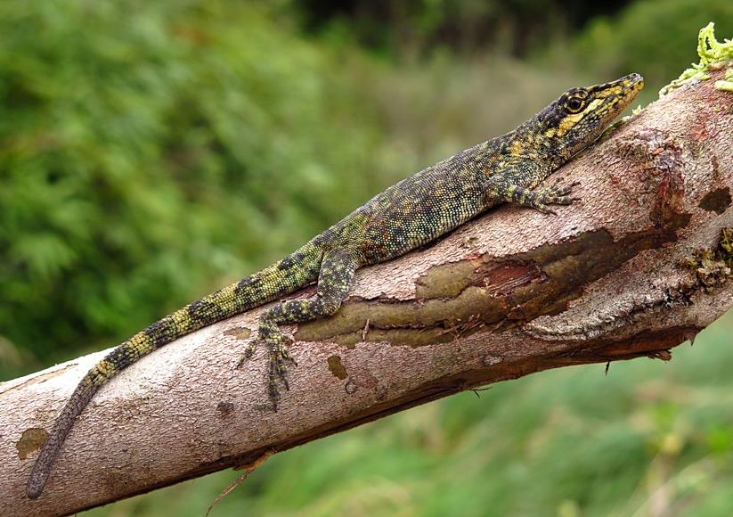

Slide 8
invalid json syntax: invalid character '\n' in string literal
South American lizards, such as the Green Iguana, Caiman Lizard, and Tepui Lizard, are fascinating creatures that play crucial ecological roles in their respective habitats. However, they face various threats, including habitat loss, illegal pet trade, and climate change, which require conservation efforts to ensure their longterm survival.

Slide 9
invalid json syntax: invalid character '\n' in string literal
South America is home to an impressive diversity of lizards, ranging from small geckolike creatures to large monitor lizards. These reptiles play a vital role in maintaining ecological balance and are threatened by various factors such as habitat loss, climate change, and illegal trade. Through responsible research, education, and community involvement, we can work towards protecting their habitats and promoting their welfare.

